Slide 1


Introduction to SSP modelling
We will discuss the basics of:
Different methods of modelling the universe
Building SSPs
Modelling spectral properties of galaxies
Associated uncertainties
Understanding star-formation
Themiya Nanayakkara
@themiyan
With contributions from Prof. Jarle Brichmann,
University of Porto, Portugal.

Slide 2
Why it is necessary to model
Observations only have a single time snapshot and limited physical information
Can use analytical models but has very large simplifications since the real Universe is very complicated

Slide 3
Hydrodanimical simulations
Some only simulate dark matter and gravity
Advantages: • Relatively simple • Physics “understood” • Large volumes possible
Disadvantages
No galaxies
Ignore effect of baryon physics on dark matter
Some may include full physics but volumes are smaller, cannot resolve individual star-forming regions

Slide 4
Semi-analytic models
Galaxies included to dark matter simulation by hand
Use analytical functions to explore the evolution
Such simulations are fast to run and easy to explore model variations but are several simplified and doesn’t consider baryon-dark matter interactions and the IGM

Slide 5


Slide 6
SSPs

Slide 7
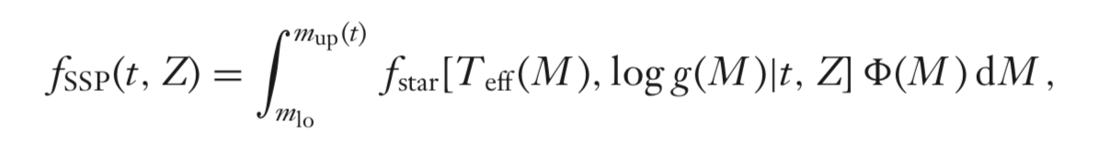
Building a SSP
SSPs require three basic ingredients:
Isochrones
Stellar libraries
IMF

Slide 8
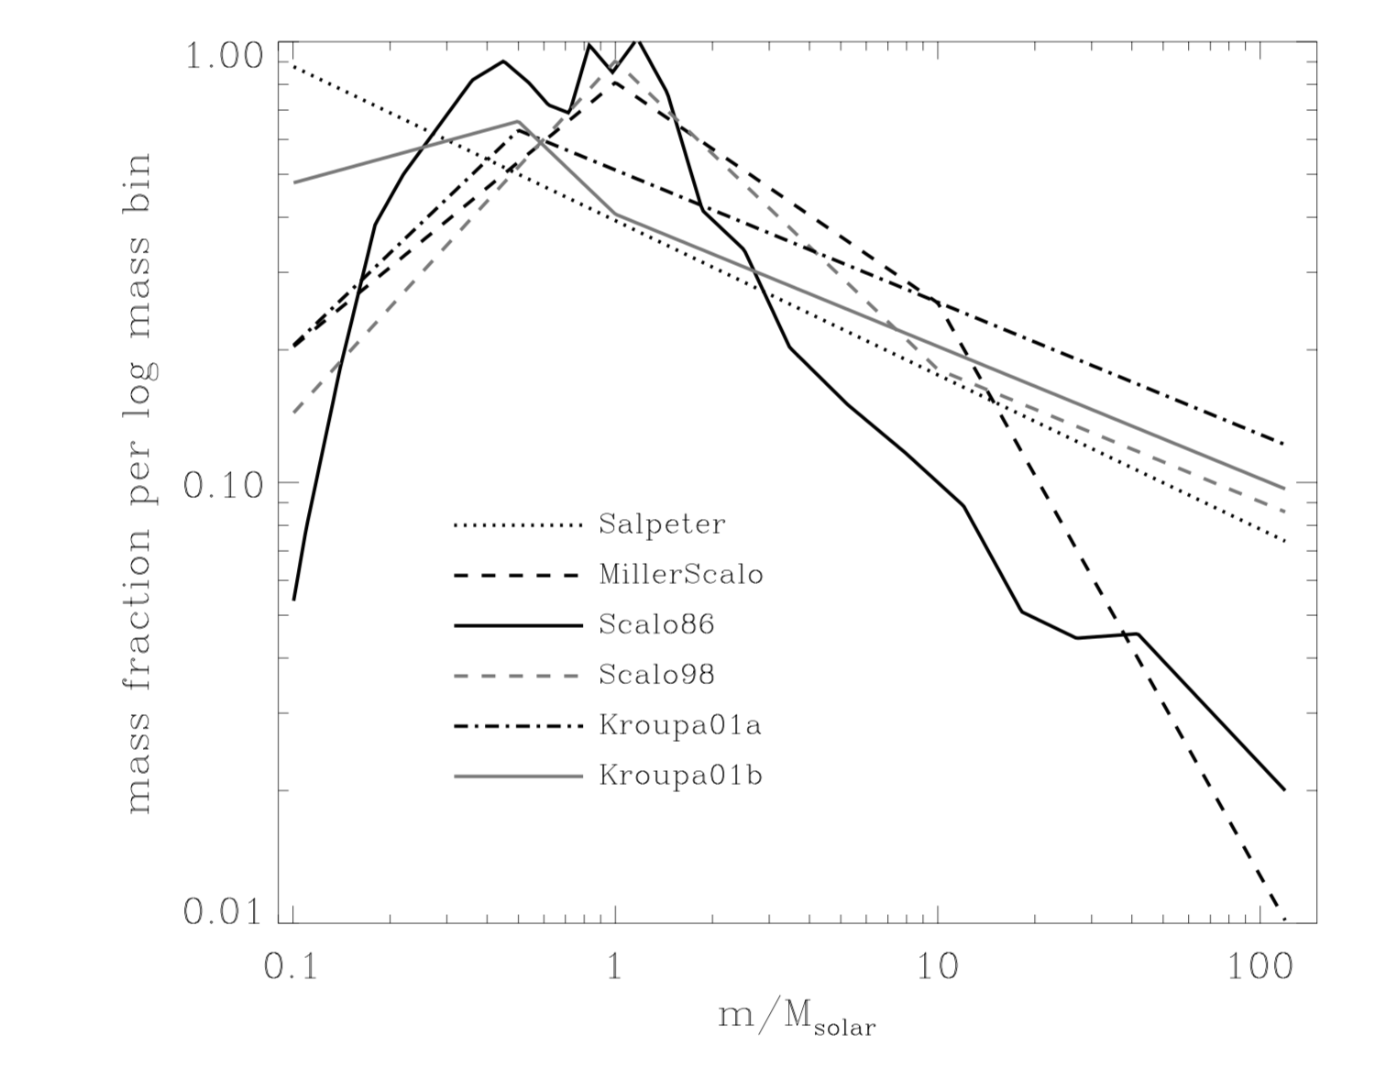
IMF
The Initial mass function of a stellar population is the distribution of birth masses of stars at a given time

Slide 10
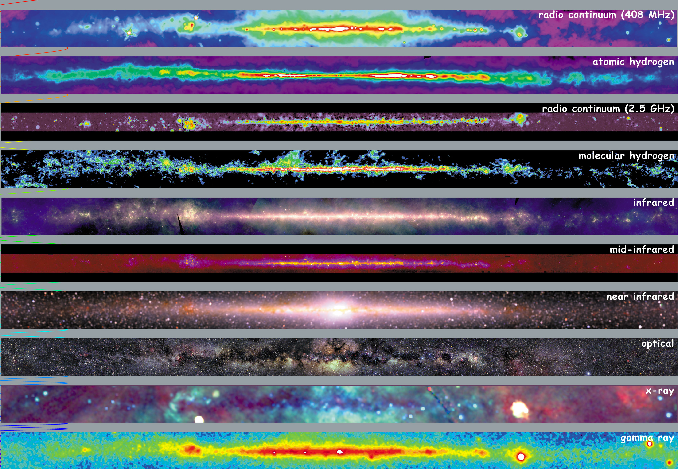
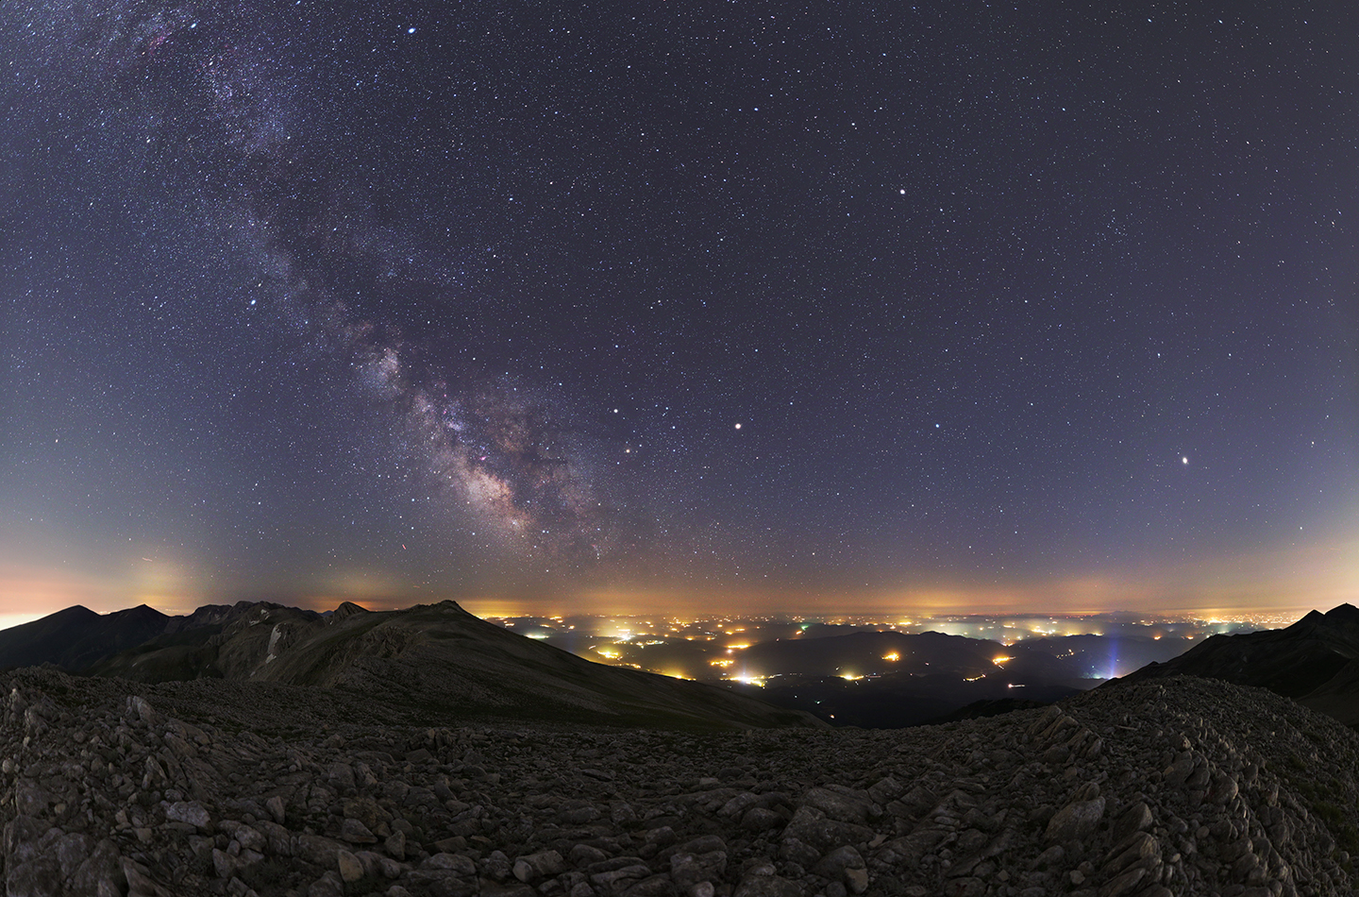
©NASA
©APOD

Slide 11

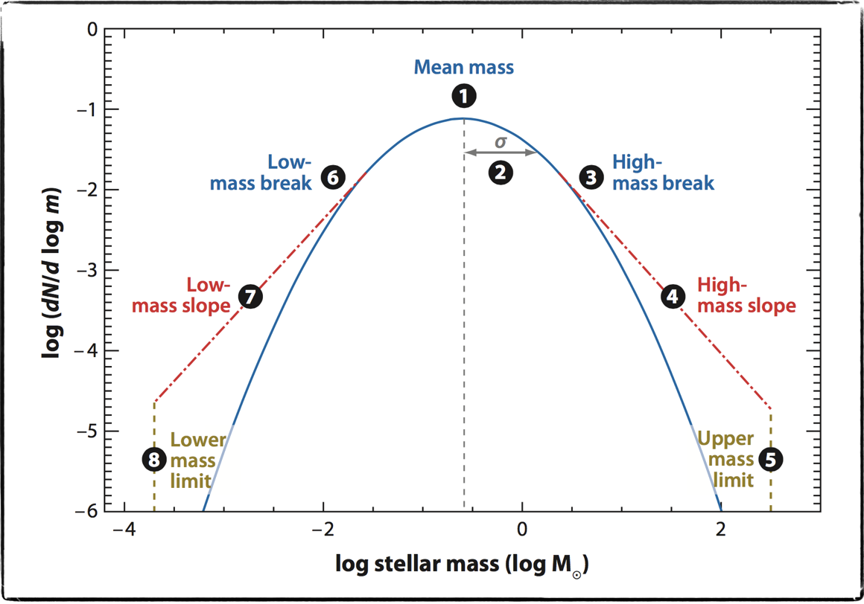

IMF is the number distribution of stars in logarithmic bins in a stellar population
M > 200M_sol
Eddington Limit
Radiation pressure ≈accretion
No accepted upper limit
M < 0.08M_sol
Cannot ignite H burning,
<<Pself gravity
No MS
Burn D, Li
Brown dwarf
©Bastian2010
Notes:
maximum expected is ~650Msol
observed maximum is ~300Msol

Slide 12
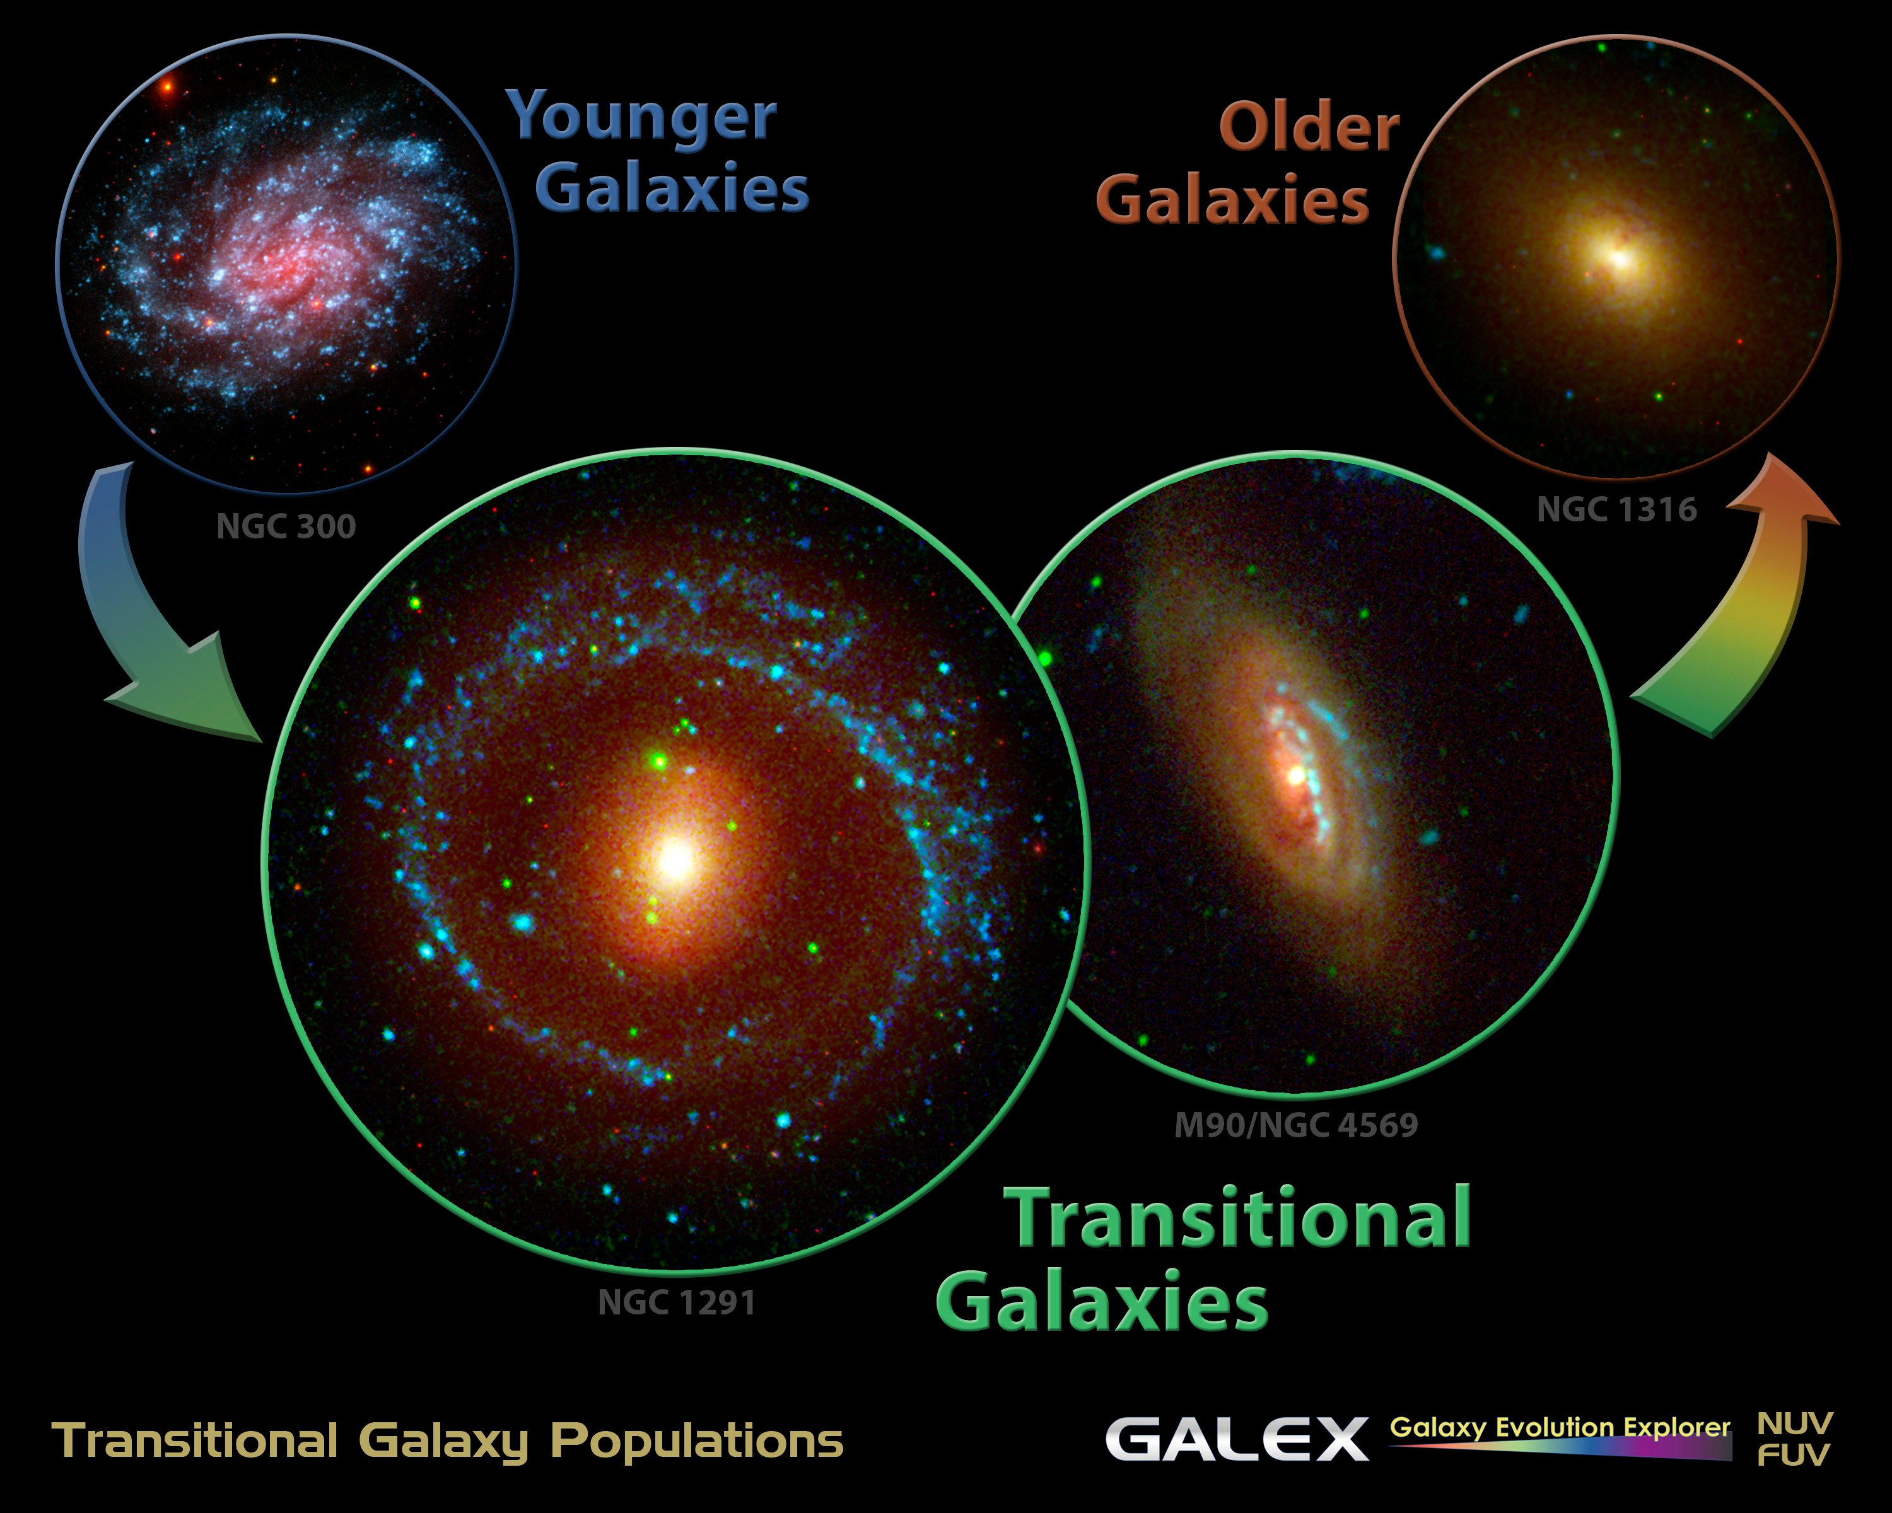

Slide 13
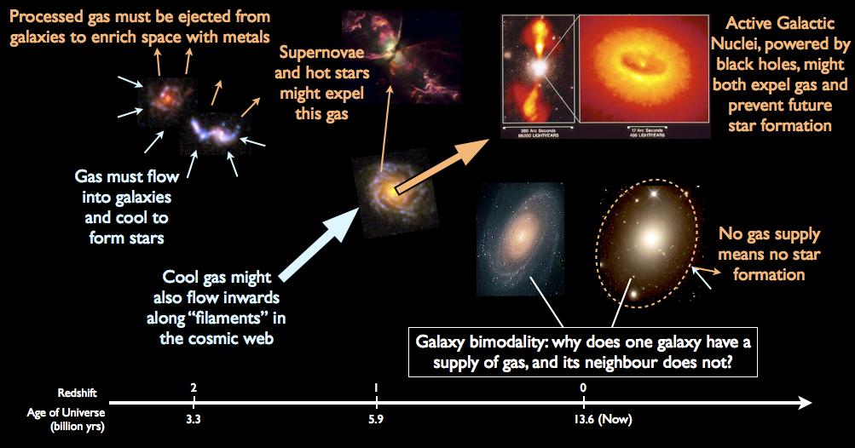

The IMF is fundamental
Measuring star-formation in galaxies
Measuring the mass of the galaxies
Understanding dark matter contents and profiles
How the galaxy would evolve
Synthetic Stellar Populations
High redshift cosmology
Energetics and phase balance of the ISM
…………………………………………………………..
©Vivienne Wild

Slide 14
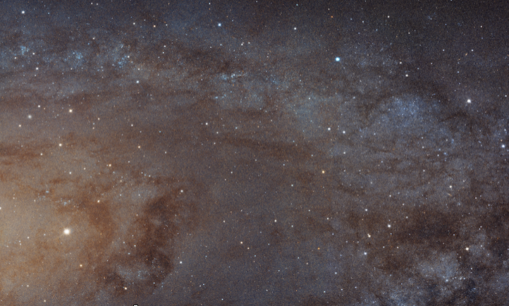
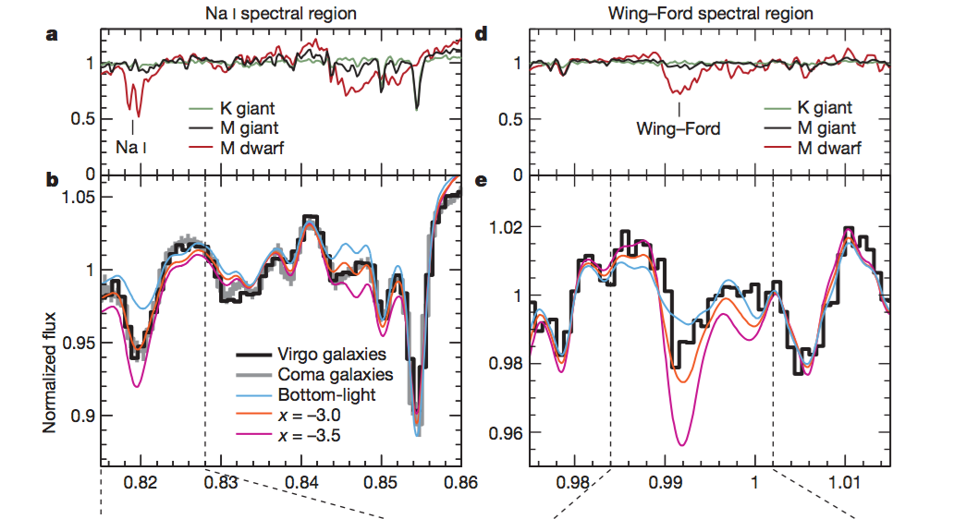
IMF can be probed using direct
or
indirect methods
Direct Methods
Indirect Methods
©HST
©van Dokkum2010
counting individual stars
use stellar population properties
Notes:
Introduce the two methods
Explain advantages and disadvantages briefly
Problems of stellar count methods
In magnitude-limited samples luminous stars are overrepresented, because they will be detected over a greater volume of space than the fainter stars. This is commonly known as the Malmquist bias.
Due to uncertainties of measured parallax measured luminosities can be systematically too large \citep{Lutz1973}.
Since high mass stars are more commonly found in the galactic disks while low mass galaxies are less confined to the disk, corrections should be made for the structure of the disk of the galaxies while also differentiating between main and post main sequence stars \citep{Miller1979}. It is also necessary to correct for unresolved multiple star systems as well
Problems of integrated light approaches
These techniques are not sensitive to low mass stellar populations, if OB stars and red super giant stars are present. At the highest mass end, there is also a possibility that there is not enough star numbers to make a significant contribution to the detected light \citep{Leitherer1998,Hoversten2008}. This technique also requires a detailed understanding of the stellar population models and the results can be only good as the models that have been used to study them. Degeneracy of the models plays a significant role in these uncertainties, especially due to the fact that effects of age, dust, metallicity, SFH and IMF cannot be disentangled easily

Slide 15
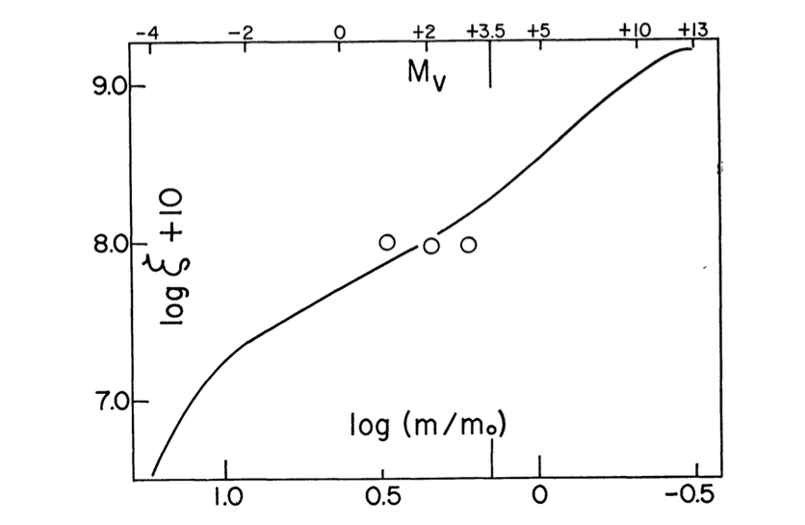
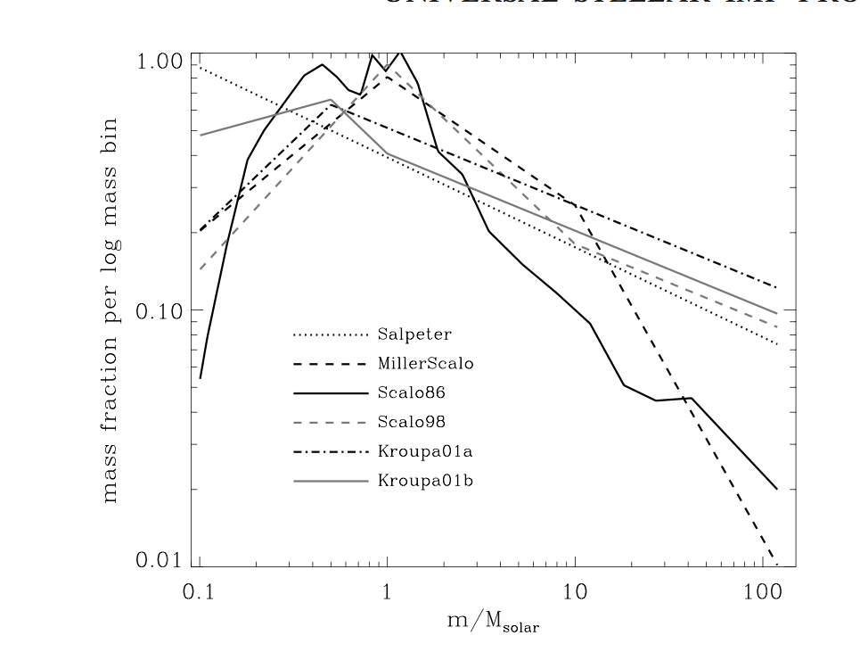
Historically we consider the IMF to be universal between Any & all types of galaxies
©Salpeter1955
©Baldry2003

Slide 16
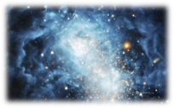
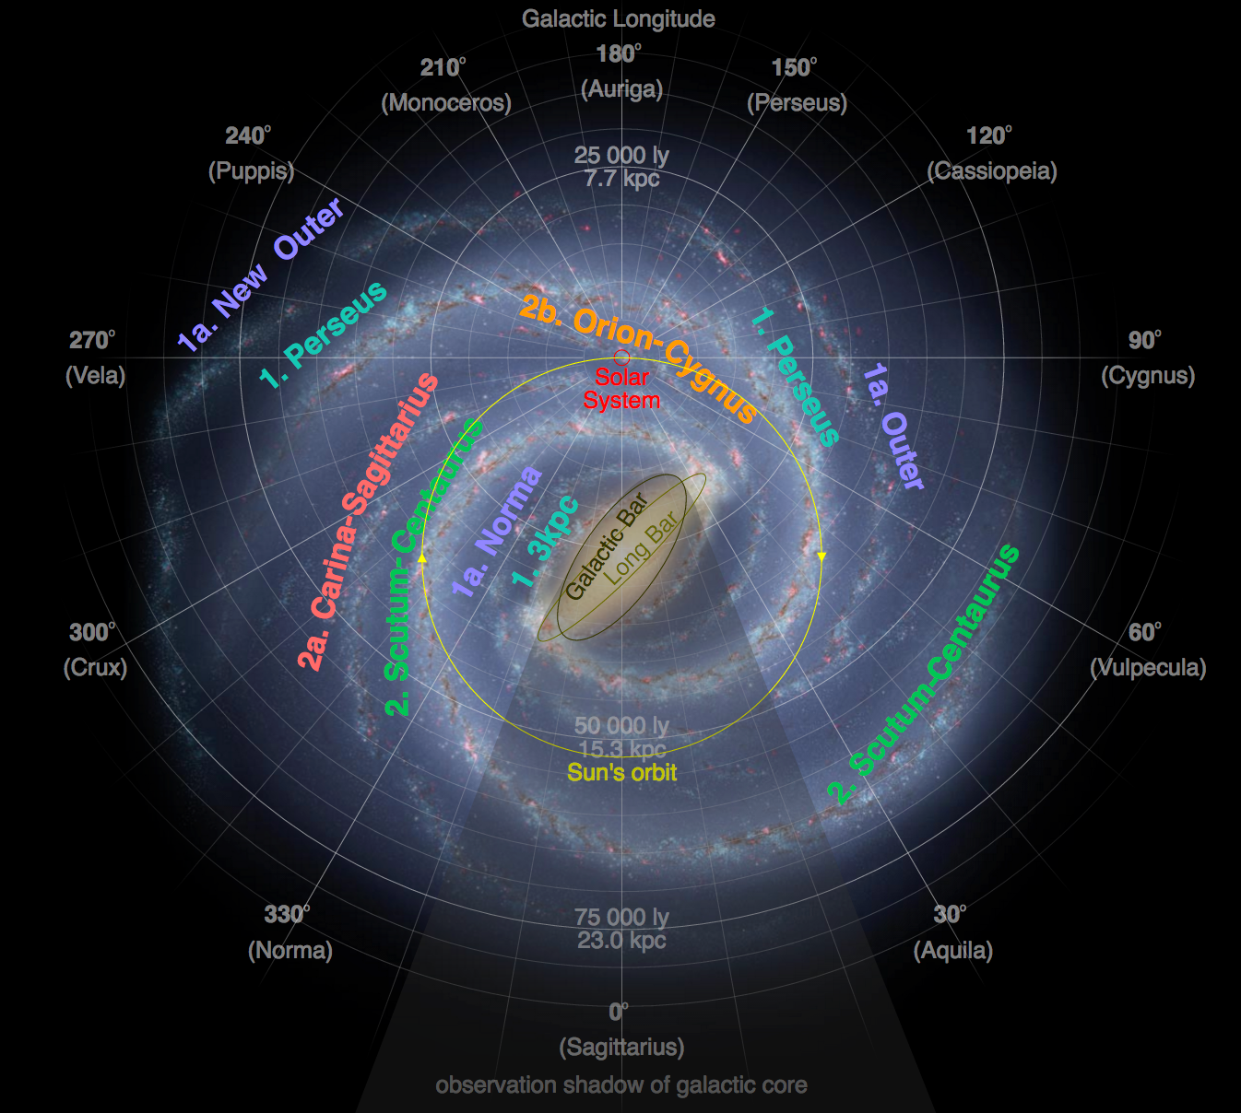
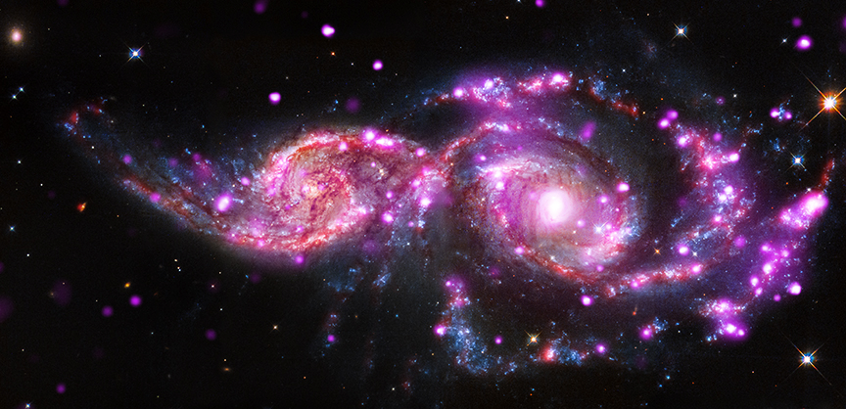
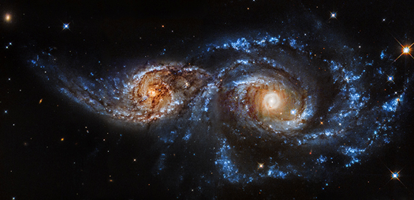
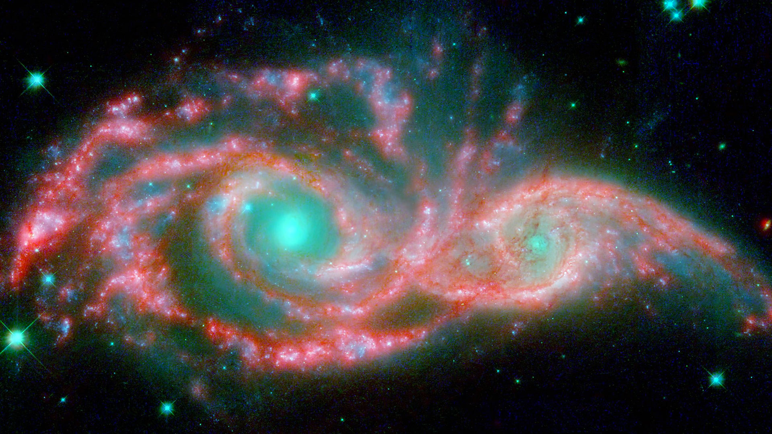
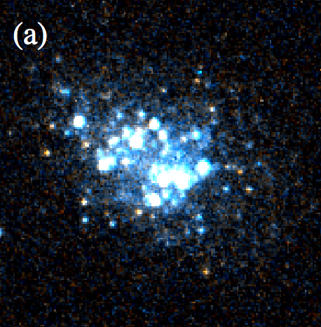

It is extremely difficult to imagine that the observed complexity of star formation results in a universal IMF (Kennicutt 1998)
radial variations
environmental variations
time variations?
Is there any observational evidence?
©Hurt
©Hirschauer2016
©HST
Notes:
env—> interaction between gas clouds lead to extra UV flux, strong winds, powerful outflows—> suppress low mass stars increasing cloud surface densities leading to radiation trapping favours the formation of high mass stars.

Slide 17
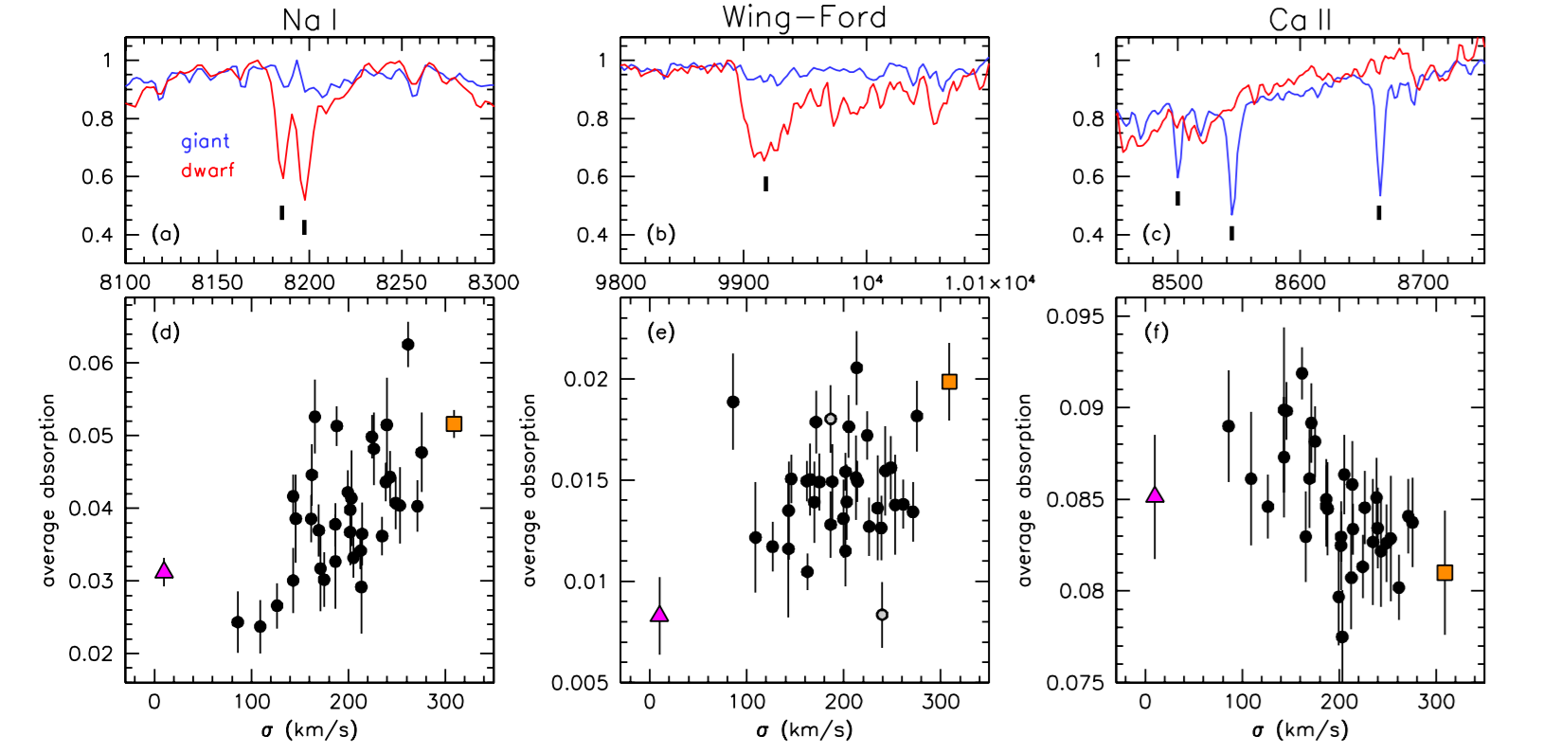
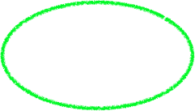
ETG absorption line/SSP studies show IMF variation with velocity dispersion
strong in dwarf stars
strong in giant stars
©van Dokkum2012
©van Dokkum2012
Notes:
“notoriously difficulty to interpret quantitatively as they rarely measure the abundance of a single element in a straightforward way”. Additionally, these features also vary with the age and metallicity of the stars in the galaxy.

Slide 18
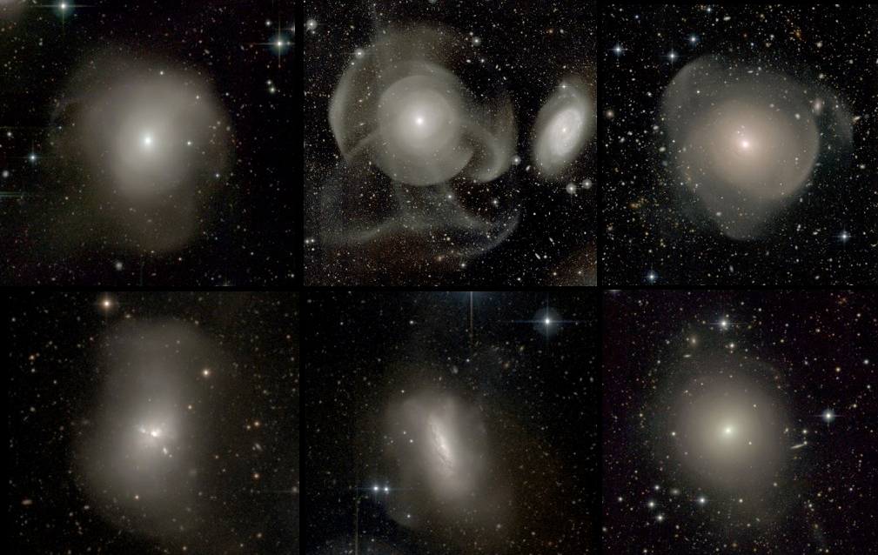
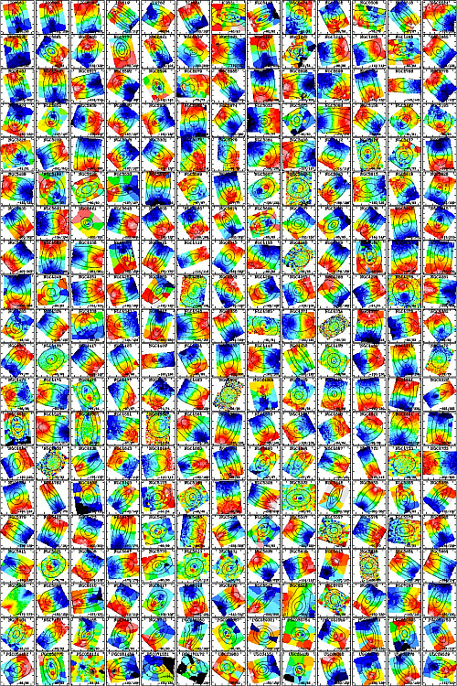
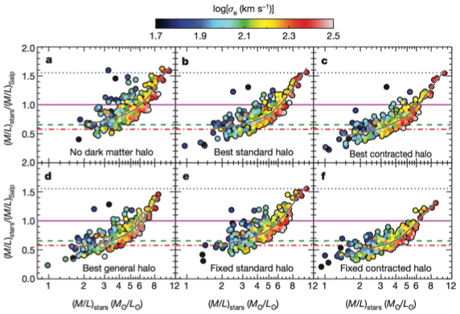


ATLAS^{3D} showed that regardless of the dark matter profile used IMF systematically changes as a function of stellar velocity dispersion
©Cappellari2012
x=-2.8 or x=-1.5
Salpeter
Kroupa
Chabrier
is this a local or global property?
Requires a model in which stars know which kind of galaxy it will end up with (assuming dark matter content stays the same)
©Duc2011

Slide 19
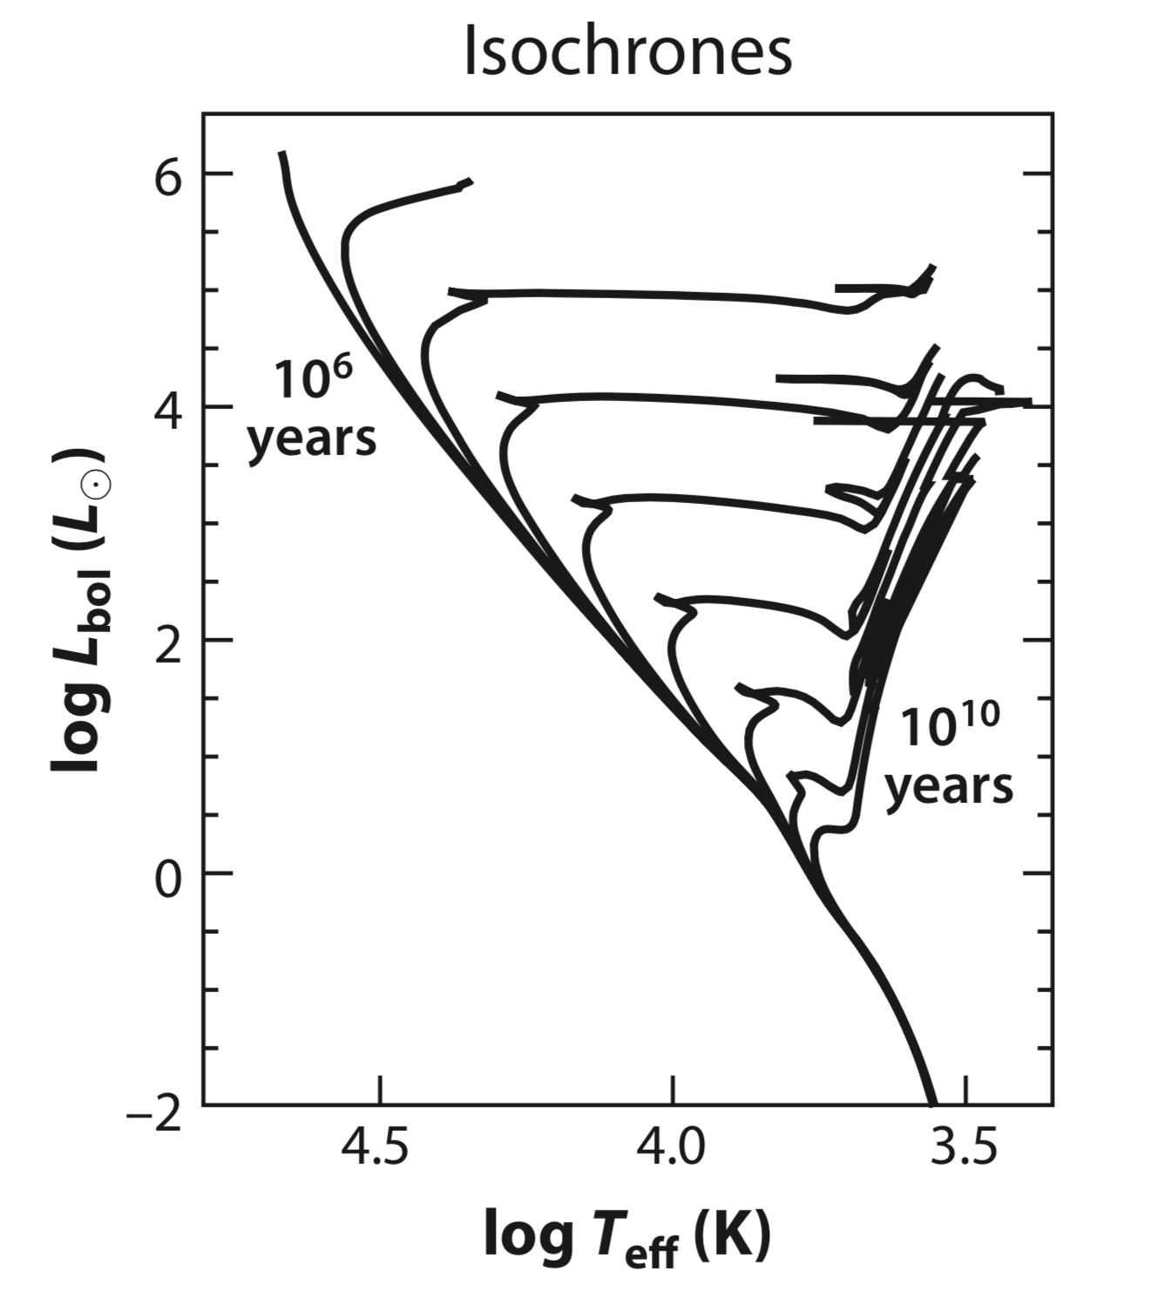
Isochrones
Specifies the location of stars in same age and metallicity in the HR diagram.
Massive stars are hotter and evolve off the main sequence faster that the less massive stars

Slide 20
Isochrones
Evolutionary tracks are discretely sampled, so special attention should be given to interpolation.
Most common tracks span a wide range in age (mass) and chemical composition.
Padova models
BaSTI models
Some models focus specially on certain types of stars
Geneva models: high mass, rotation, W-R stars but no small mass stars
Y2 and Victoria Regina models: RGB stars, HB stars
Lyon models: brown dwarf stars, very low mass stars
MESA code: highly modular, and sophisticated stellar evolution code that includes the latest stellar interior ingredients, including opacity tables, equations of state, nuclear reaction networks, and surface boundary conditions

Slide 21
Isochrones
Effects of rotation
Only a few SSP codes consider effects of stellar rotation. i.e., Geneva models, MIST models
Rotation can increase the life time of MS stars by ~25%, lowers the effective surface gravity, lowers the opacity in the radiative envelope, increases the luminosity, and changes the ratio of red to blue supergiants.
The mixing to the surface of hydrogen burning products caused by rotation will also affect the number and type of WR stars.
Additionally, rotation can increase the amount of ionising photons by ~1 magnitude and make the colours bluer by 0.1-1 magnitude.

Slide 22
Isochrones
Effects of binaries
So far only BPASS models incorporate effects of binary evolution in stars
Binaries will increase the life-time of massive stars, lead to QHE effects giving rise to rapidly rotating stars (contributing to similar effects to rotation).
Binaries will decrease the metallicity threshold to produce W-R stars.
May also create blue straggler stars and extreme HB stars, which would suggest that binary evolution can affect older stellar populations as well.
Currently BPASS models does not consider stellar rotation

Slide 23
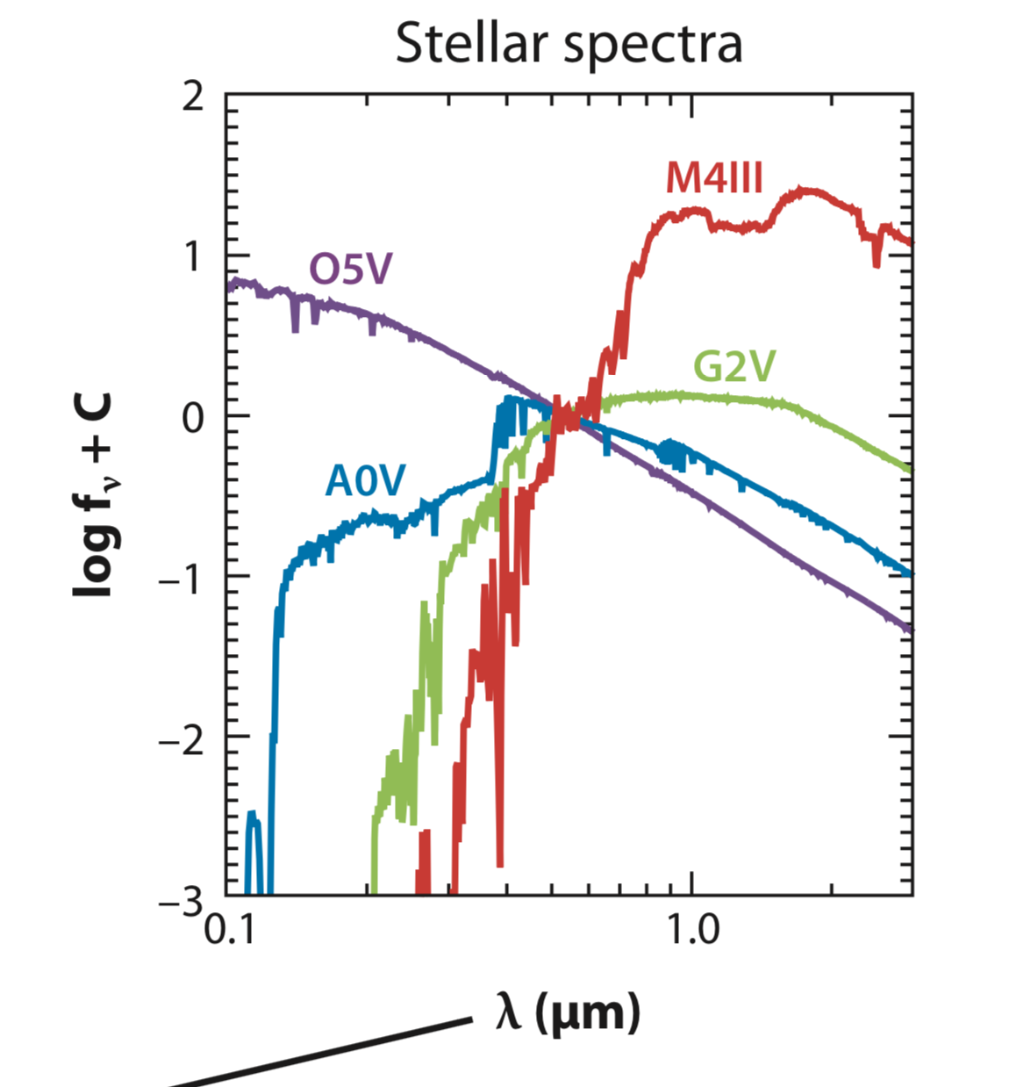
Stellar spectra
Stellar spectra are necessary to convert the population of stars in to an observed spectral energy distribution (SED)

Slide 24
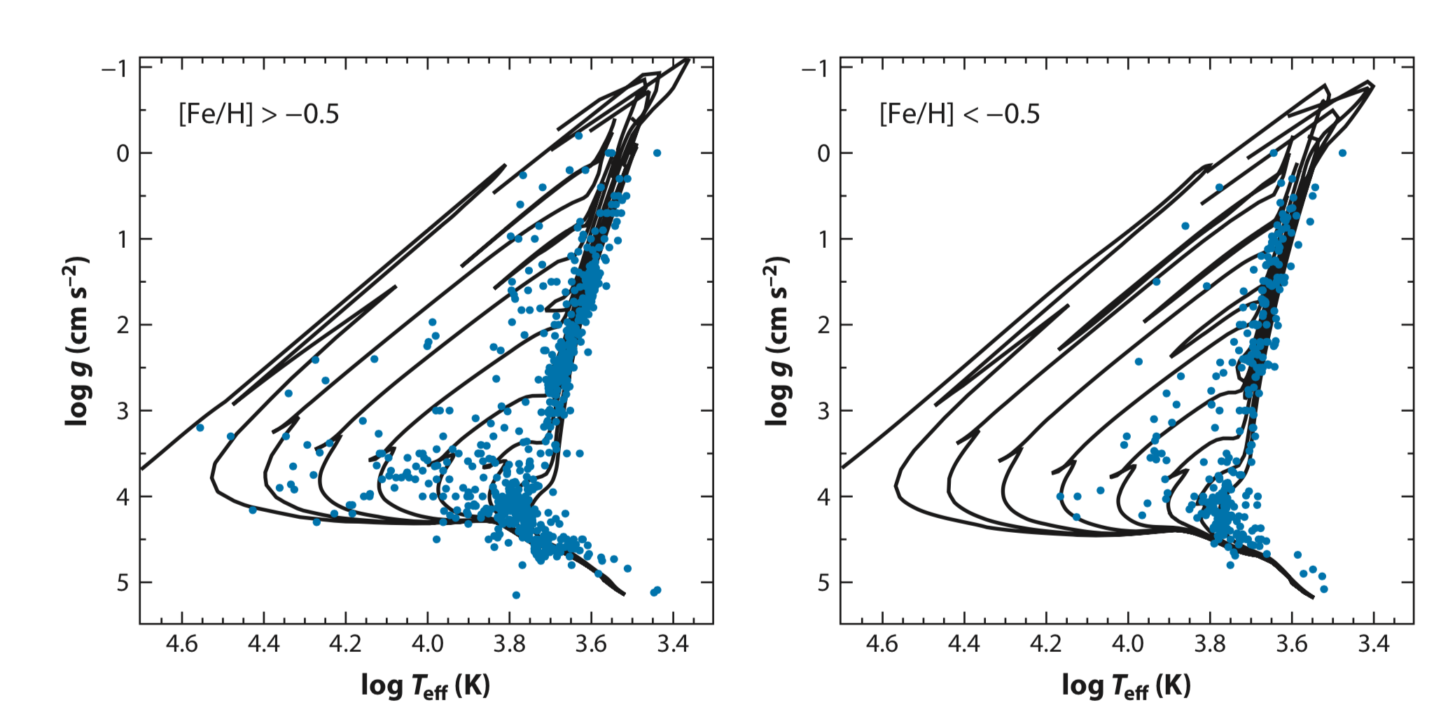
Stellar spectra
Severely limited in parameter space due to lack of variety in stars in the solar neighbourhood.
As shown by the figure, even MILES, the largest empirical spectral library only sparsely covers the upper main sequence and supergiants.
Assigning physical parameters to stars also leads to considerable uncertainties.

Slide 25
Stellar Spectra
To overcome limitations in empirical stellar libraries theoretical stellar libraries can be used.
Libraries are only as good as the input atomic and molecular parameters and the approximations made in the computation of the models

Slide 26
Stellar remnants are also necessary to account for the total mass budget of a galaxy
The relationship between initial ZAMS stellar mass and the final remnant stellar mass is not well constrained
More vital at later ages:
e.g., 13 Gyr stellar population
Supernovae and Feedback
13Gyr stellar population
40% of initial mass in ISM
60% in stars + remnants
7% neutron stars
73% white dwarfs
20% black holes
25% in stellar remnants
Notes:
13 Gyr only 60% of the mass remains in stars or stellar remnants; the other 40% has returned to the ISM. Of the remaining stellar mass, 25% is locked in stellar remnants. Of the total remnant mass, 73% is comprised of white dwarfs, 7% is in neutron stars, and 20% is in black holes. These numbers were computed assuming solar metallicity and a Kroupa (2001) IMF, with the initial–final mass relations from Renzini & Ciotti (1993).

Slide 27
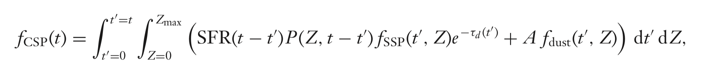
Composite stellar populations
Stars with a range of ages
Stars with a range of metallicities
Dust
Notes:
(a) they contain stars with a range of ages given by their SFH; (b) they contain stars with a range in metallicities as given by their time-dependent metallicity distribution function, P(Z, t); and (c) they contain dust.

Slide 28
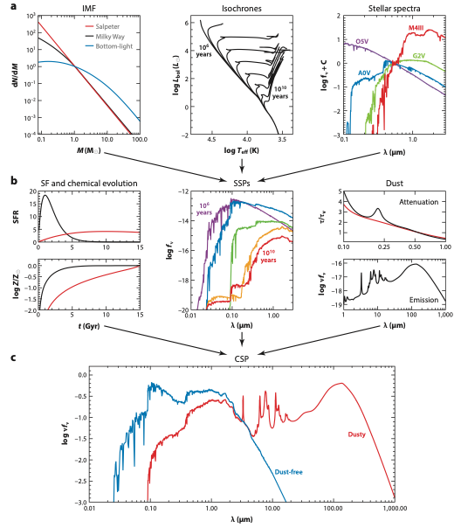

Composite stellar populations
Composite stellar populations may resemble close to reality spectral energy distributions
However, there are a lot of free parameters and uncertainties, which can be tuned to match data with models: we don’t know what is correct and what is not
So use observational data in galaxy populations to get some constraints

Slide 29
Nebular emission
Adding nebular emission introduces further complexities
Photoionisation codes such as CLOUDY or MAPPINGS is generally used on top of SSPs to generate nebular emission
A lot of assumptions go into deriving nebular lines, thus is generally SSPs do not produce emission lines (have to do this separately)

Slide 30


continuum
Ηα
B
G
G
A
O
A
O
A
G
Lyman continuum
n=2 —> n=1
G
A
>>A1216Å
B
O
B
O
B
Lyman leakage

Slide 31
Star formation
Multiple effects related to star formation, magnetic effects, feedback need to be taken into account.
Simulations show us an insight.

Slide 32

Formation of a massive star cluster by global collapse
http://www.mso.anu.edu.au/~krumholz/movies.html

Slide 33
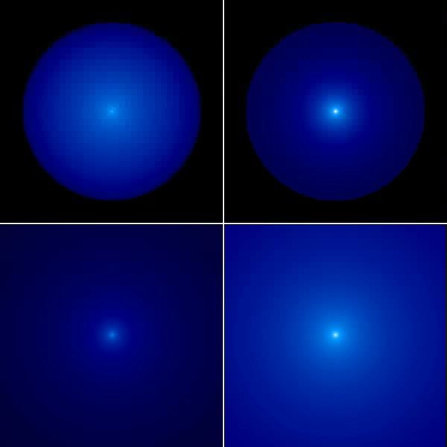
Formation of a massive star with radiation pressure feedback; left = face-on view, right = edge-on review, top = long view, bottom = zoom view
http://www.mso.anu.edu.au/~krumholz/movies.html

Slide 34
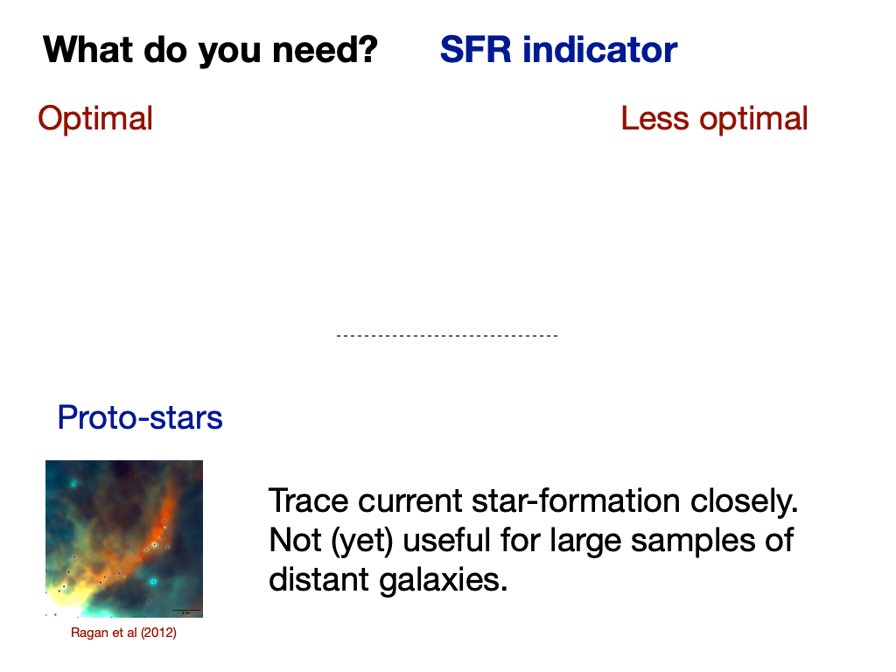
How can we measure star-formation?

Slide 35
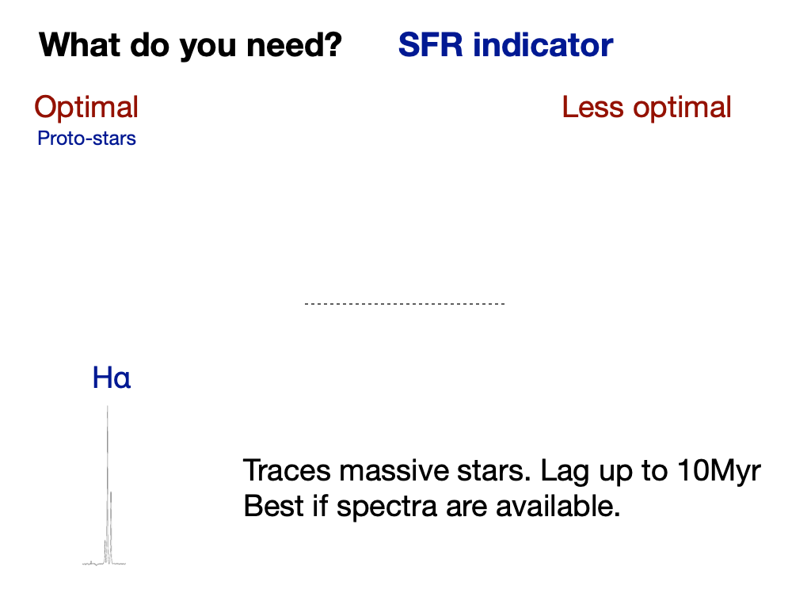

Slide 36
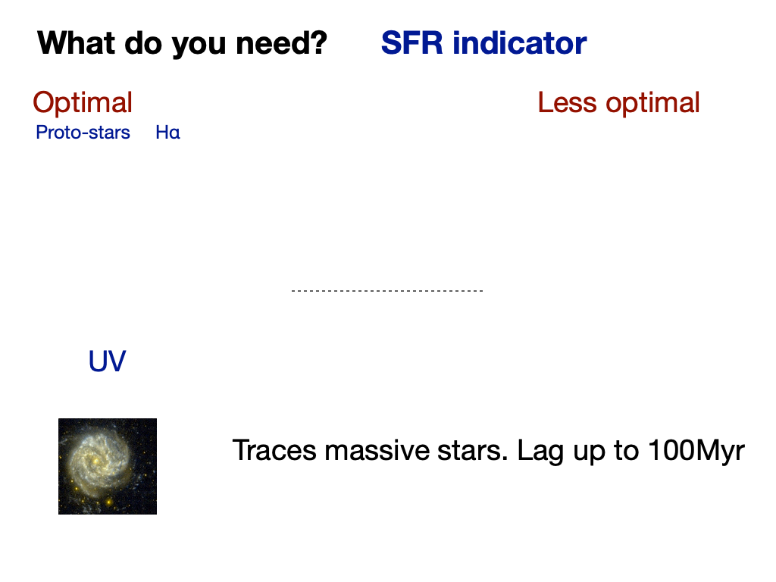

Slide 37
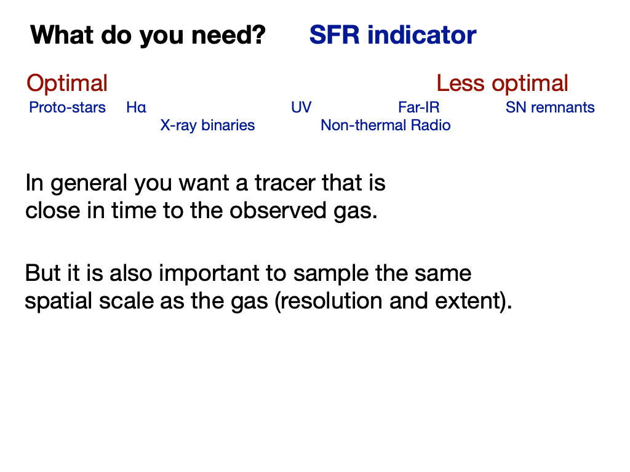

Slide 38
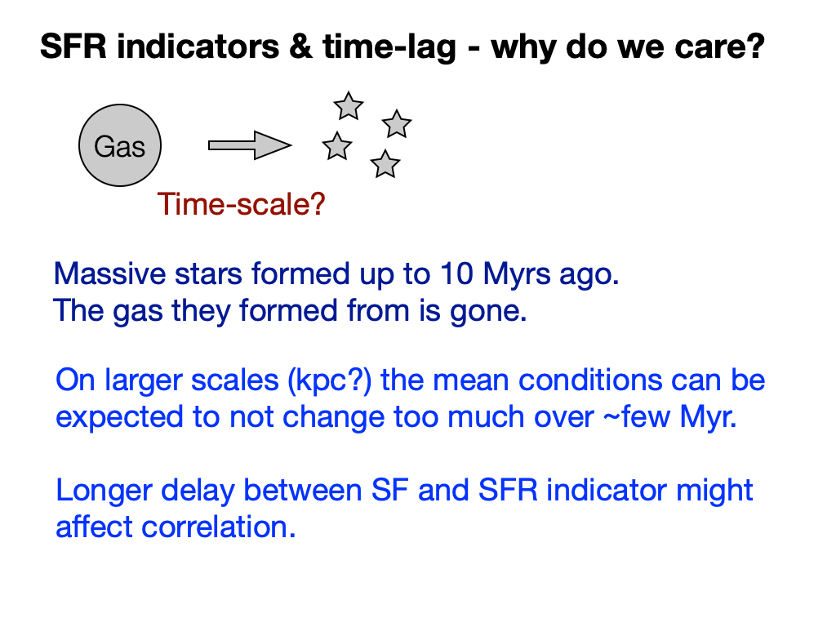

Slide 39
Other physical parameters
Similarly we can use emission/absorption lines to measure metallicity of galaxies
SFH, luminosity, or a combination using SED fitting techniques can tell us about stellar mass
By modelling the observed spectra/SED with different dust laws, using FIR/submm spectra or comparing emission line ratios we can learn about dust
We will revisit these tomorrow in a more practical way when we use SSP models to match with observations to infer galaxy properties

